Slide 1

Reddit Headline Sentiment Analysis
Taylor Imhof
Bellevue University | DSC 680
Project Two Milestone 3 (Presentation)

Slide 2
Agenda
Business Problem
Dataset Overview
Project Methodology
Analysis
Assumptions/Limitations/Challenges
Future Uses/Recommendations
Ethical Assessment
Questions

Slide 3
Business Problem
Organization wants to analyze customers responses
Comments are in the form of comments/reactions
Natural Language Processing (NLP) – Sentiment Analysis

Slide 4
Dataset Overview
Retrieved from Reddit’s Application Programming Interface (API)
Python Reddit API Wrapper (PRAW)
Headlines of ~1k posts to popular r/politics sub-reddit

Slide 5
Project Methodology
Retrieve sentiment analysis polarity scores
NLTK – VADER
SentimentIntensityAnalyzer (SIA)
Positive, negative, neutral, and compound
Store into Pandas dataframe
Encode compound aggregate into labels
-1: negative, +1: positive, 0: neutral

Slide 6
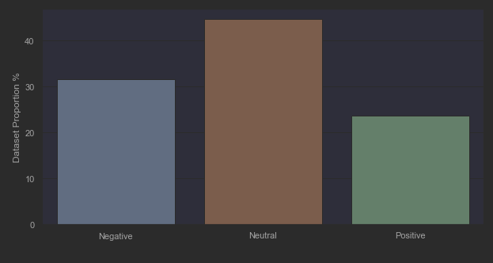
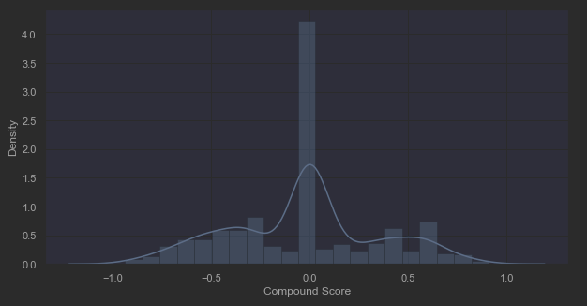
Analysis
Data visualizations
Seaborn & Matplotlib libraries
Significant bias towards neutral label
More negative than positive

Slide 7
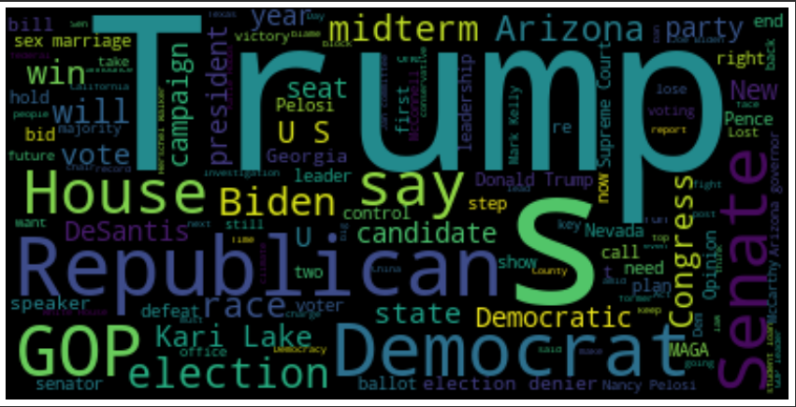
Analysis
Tokenization and stop-words removal
Common positive: ‘trump’, ‘democrats’, ‘senate’
Common negative: ‘trump’, ‘election’, ‘gop’
Word cloud
Most common words
Size indicates relative distribution frequency
Model seems to have fitted quite accurately

Slide 8
Assumptions/Limitations/Challenges
Sentiment analysis on politically-slanted language might not be applicable to other domains
Organization might not see as much benefit
PRAW only allows for ingestion of approx. 1k headlines

Slide 9
Future Uses/Recommendations
Sentiment analysis model could be used on other topics
E.g., sports, travel, gaming
Train on different formats besides headlines
More natural conversations between human beings
Continue collecting headlines using PRAW
Consolidate into single, larger dataset

Slide 10
Ethical Assessment
Data privacy/consent
Would the users want me using their written communication?
Lack of data usage laws and regulations
Efforts in pipeline to increase user data protection and ownership

Slide 11

Questions?

